Slide 1
Ridership Forecasting with STOPS for Transit Project Planning
OMPO STOPS Training WSP/Dunbar Transportation Consulting LLC

Slide 2
Content sourced from:
NTI/FTA STOPS Training Phoenix, June 2019
and
STOPS User Guide v2.50 DRAFT 2019-04-18

Slide 3
Background
Simplified Trips-On-Project Software (STOPS)
User Benefits → Trips On Project
Originally intended for smaller regional agencies
Ridership Forecasting for project planning
Not substitute for non-transit projects or RTP development
Modelers should derive forecast insights from model outputs
OMPO STOPS Training WSP/Dunbar Transportation Consulting LLC

Slide 4
STOPS and the FTA CIG Program
Discretionary Capital Investment Grants (CIG) Program
FTA: project ratings and funding recommendations
Several rating criteria dependent upon predicted riders
STOPS origins in CIG streamlining (2009)
STOPS provision of all CIG-required rider measures
Evolution of STOPS capabilities
OMPO STOPS Training WSP/Dunbar Transportation Consulting LLC

Slide 5
Topics
Design standards
National calibration
How STOPS works – Overview
OMPO STOPS
Inputs – Networks and Other Data
Schedule-Based Transit Path-Builder
Current Year Travel Patterns
Initial Travel Patterns for STOPS-Incremental
Mode & Path Choice
Calibration & Test Run
STOPS File Structure
STOPS Interface
OMPO STOPS Training WSP/Dunbar Transportation Consulting LLC

Slide 6
Design Standards
OMPO STOPS Training WSP/Dunbar Transportation Consulting LLC

Slide 7
Design Standards
FTA’s design standards for “a simplified method”
Focus on trips on major-capital projects → STOPs
Keep it simplified for users
Make it reasonably accurate
Make it operate on Windows-based computer
OMPO STOPS Training WSP/Dunbar Transportation Consulting LLC

Slide 8
Design Standards and Outcomes
Outcomes in STOPS
Fixed-guideway focus, but detailed system-wide representation
Calibration against a range of rider-survey datasets
Validation against a wide range of projects/systems
Required inputs limited to readily-available sources
Level of engagement at user option: simple to sophisticated
OMPO STOPS Training WSP/Dunbar Transportation Consulting LLC

Slide 9
Design Standards and Outcomes
Outcomes in STOPS
Efficient application on standard Windows computer
GIS package is a necessary tool for some tasks
No other transportation software needed, although scheduling software might be preferred to STOPS GTFS editor for transit networks
OMPO STOPS Training WSP/Dunbar Transportation Consulting LLC

Slide 10
Model Application
Multiple application modes
STOPS-synthetic
STOPS-synthetic plus special markets
STOPS-incremental
OMPO STOPS Training WSP/Dunbar Transportation Consulting LLC
Notes:
Red arrow – STOPS Incremental for OMPO as 2012 Survey was available

Slide 11
STOPS Application Modes
STOPS-synthetic
Invents transit demand patterns from the CTPP worker flows, manipulated to match transit counts
Strength
Responds to mandate for simplified method to predict total number of trips on a project without lots of local data collection and model development/refinement
Weakness
May not predict the details of transit demand patterns sufficiently well to support other project-planning tasks
OMPO STOPS Training WSP/Dunbar Transportation Consulting LLC

Slide 12
STOPS Application Modes
STOPS-synthetic plus special markets
Adds data for important transit markets that are not related to worker flows and therefore cannot be predicted by STOPS-synthetic alone
Strength
Fills gaps in the representation of transit markets produced by STOPS-synthetic while minimizing data collection costs
Weakness
Adds costs and requires clear targeting of data collection from somewhat ambiguously defined “special” markets
OMPO STOPS Training WSP/Dunbar Transportation Consulting LLC

Slide 13
STOPS Application Modes
STOPS-incremental (OMPO APPLICATION)
Uses rider survey data (!) to represent current transit travel patterns thereby tasking the models only to predict changes in those patterns caused by transit service changes and growth
Strength
Forecasts are grounded in actual transit travel patterns rather than synthesized (made-up) model predictions of those patterns
Weakness
Time and cost of data collection; and applicability only to established transit markets
OMPO STOPS Training WSP/Dunbar Transportation Consulting LLC

Slide 14
Choice of Application Mode
Depends, in part, on what you are doing:
Just filling in FTA’s templates
Just looking for a second number to compare with number prepared with local travel models
Attempting to understand the ridership potential of a project under development
Comparing ridership potential across alternatives
Looking for details to help size facilities and refine the transit service plan
Less Rigor
More Rigor
OMPO STOPS Training WSP/Dunbar Transportation Consulting LLC

Slide 15
Choice of Application Mode
Less rigor
STOPS-synthetic “out of the box”
Required inputs only; no counts; little calibration
Just coding of the Build scenario
Increasing rigor
Counts; additional data; closer calibration
STOPS-incremental
Probably more time, effort, and cost
OMPO STOPS Training WSP/Dunbar Transportation Consulting LLC

Slide 16
Choosing an Application Mode
With a good rider survey already in hand and a project that serves a well-developed transit market
Incremental approach calibrates more readily and has lower likelihood of travel-market distortions
Therefore, STOPS-incremental is more likely to provide reliable predictions of future ridership patterns
For larger, more complex, and riskier projects, the advantages of STOPS-incremental may suggest that the collection of rider survey data is desirable where appropriate data are not currently available
OMPO STOPS Training WSP/Dunbar Transportation Consulting LLC

Slide 17
National Calibration
OMPO STOPS Training WSP/Dunbar Transportation Consulting LLC

Slide 18
National Parameter Development
Traditional approach
“Estimation” with econometric software
Data from an individual metro area
Struggles with relative values of parameters on highly inter-correlated attributes of travel modes and traveler characteristics
OMPO STOPS Training WSP/Dunbar Transportation Consulting LLC

Slide 19
National Parameter Development
Approach for STOPS
Starting-point parameter values
Built on outcomes of 40 years of parameter estimation
Constrained to be consistent in path-building and mode choice
Iterative adjustment of starting-point parameters
Adjustments made to path-building parameters to match paths reported in the surveys and by on-line path-finders
Mode choice parameters revised accordingly
Calibration and validation against datasets assembled from many metro areas and transit systems
OMPO STOPS Training WSP/Dunbar Transportation Consulting LLC

Slide 20
National Parameter Development
STOPS comes with a “national” static calibration that tunes its default understanding of fixed-guideway trips and all transit trips by:
Trip purpose, auto-ownership, and access mode
Transit access/egress time, run-times, frequencies
Fixed-guideway effects compared to local bus
Data are from database of published rider surveys, count data, and other ridership information
OMPO STOPS Training WSP/Dunbar Transportation Consulting LLC

Slide 21
National Parameter Development
STOPS comes with a “national” dynamic validation that strengthens its ability to predict the ridership on new fixed-guideway projects
Data are from:
Public GTFS schedules from before and after project opening
Reported total project ridership
OMPO STOPS Training WSP/Dunbar Transportation Consulting LLC

Slide 22
National Parameter Development
Iterations and model adjustments
Observations on residuals vs. rider-survey data in previous trials
Hypotheses on behaviors not yet captured
Revised relationships, new variables, and/or updated parameters
New application to full set of systems/projects
Repeated until plausible explanation of behavior yields an acceptable fit to the data
OMPO STOPS Training WSP/Dunbar Transportation Consulting LLC

Slide 23
National Parameter Development
STOPS calibration and validation based on data that represent a wide range of conditions not found in a single metro area
Solid grasp of:
Impacts of introducing a new mode that is not currently present in the metro area’s transit system
Difference between the introduction of a new mode and expansion of an existing fixed-guideway mode
Sensitivity to changes in service levels – large and small
OMPO STOPS Training WSP/Dunbar Transportation Consulting LLC

Slide 24
National Parameters – Data Sources
Static Calibration
Metro area | Commuter Rail | Heavy Rail | Light Rail | Streetcar | BRT | Local Bus
Atlanta |  | ● |  |  |  | ●
Charlotte |  |  | ● |  |  | ●
Denver |  |  | ● |  |  | ●
Kansas City |  |  |  |  |  | ●
Norfolk |  |  | ● |  |  | ●
Phoenix |  |  | ● |  |  | ●
Salt Lake City | ● |  | ● |  | ● | ●
St. Louis |  |  | ● |  |  | ●
This list, and the list on the next slide, document the metro areas used in the grand recalibration of STOPS for Version 2.5
OMPO STOPS Training WSP/Dunbar Transportation Consulting LLC

Slide 25
National Parameters – Data Sources
Dynamic Validation
Metro area | Commuter Rail | Heavy Rail | Light Rail | Streetcar | BRT
Norfolk |  |  | ●
Orlando | ●
Nashville |  |  |  |  | ●
Denver West |  |  | ●
Phoenix NW |  |  | ●
Phoenix Mesa |  |  | ●
Grand Rapids |  |  |  |  | ●
Seattle |  |  |  | ●
NY 2nd Ave. |  | ●
DC Silver Line |  | ●
DC Streetcar |  |  |  | ●
OMPO STOPS Training WSP/Dunbar Transportation Consulting LLC

Slide 26
National Calibration Results
Comparison of STOPS vs. Observed Ridership (Dynamic Test)
OMPO STOPS Training WSP/Dunbar Transportation Consulting LLC

Slide 27
Two Cautions
1. Details matter
Effective district and station group definitions
Accurate count data
Accounting for special markets
Simplified ≠ sloppy!!
(And simplified ≠ sketch, either)
OMPO STOPS Training WSP/Dunbar Transportation Consulting LLC

Slide 28
Two Cautions
2. Forecasting is an uncertain business; some sources of uncertainty:
The characteristics of the project itself
Background projections of population and employment
Differentiation from competing transit systems
The accuracy of the forecasting tools
Uncertainties must be characterized, quantified, and communicated to decision-makers
OMPO STOPS Training WSP/Dunbar Transportation Consulting LLC

Slide 29
How STOPS Works -- Overview --
OMPO STOPS Training WSP/Dunbar Transportation Consulting LLC

Slide 30
A Typical Transit Forecasting Model
person trips
Fundamental structure of:
Conventional trip-based models
Newer activity-based models
STOPS-synthetic
STOPS synthetic/special markets
STOPS incremental
In STOPS, mode choice and assignment models come calibrated and validated against national datasets
highway network
mode choice
transit network
TRANSIT TRIPS
assignment
transit volumes
OMPO STOPS Training WSP/Dunbar Transportation Consulting LLC

Slide 31
Local Calibration of STOPS
Incremental
(Adjusted)
invented person trips
Objectives
Localize the “national” models
Mode choice
Transit assignment
Train the mode choice model to reproduce the transit trips measured in a rider survey
Invent a set of person-trips that supports the mode choice model in this task
current highway network
localized mode choice
current transit network
PREDICTED TRANSIT TRIPS
localized assignment
predicted transit volumes
OMPO STOPS Training WSP/Dunbar Transportation Consulting LLC

Slide 32
Local Calibration of STOPS
Incremental
(Adjusted)
invented person trips
person-trip builder
current transit counts
current highway network
transit survey
localized mode choice
person trips =
transit trips
÷
transit share
CTPP transit%
person trips =
transit trips
÷
transit share
[adjusted to counts]
current transit network
CURRENT TRANSIT TRIPS
localized assignment
transit trips ≡
survey data trips !!
current transit volumes
OMPO STOPS Training WSP/Dunbar Transportation Consulting LLC

Slide 33
Local Calibration of STOPS – Honolulu Application
OMPO – 2017 Calibration
2012 On Board Survey
2017 APC Data/2015 APC Data
2015 Population/Employment and highway skim data
Uses transit trips from On-Board Survey to develop person trips
Uses mode share from CTPP
OMPO STOPS Training WSP/Dunbar Transportation Consulting LLC

Slide 34
Forecasting in the Current Year
The calibrated model!
predicted person trips
Application of calibrated STOPS
Regardless of selected method
Synthetic
Synthetic+special markets
Incremental
Virtues of current year FIRST
Clarifies QC checks
Fosters interpretation
Helps to identify insights
(Meets CIG requirements)
current highway network
localized mode choice
current transit network
PREDICTEDTRANSIT TRIPS
localized assignment
predicted transit volumes
OMPO STOPS Training WSP/Dunbar Transportation Consulting LLC
Notes:
So far all we have done for OMPO is current year – which is actually 2019 count data with 2015 P/E and 2012 OBS. Not ideal but a place to start.

Slide 35
Forecasting in the Current Year
predicted person trips
predicted person trips
current highway network
localized mode choice
current highway network
localized mode choice
No-build transit network
NO-BUILD TRANSIT TRIPS
Build transit network
BUILD TRANSIT TRIPS
localized assignment
localized assignment
No-build transit volumes
Build transit volumes
=changed from the validation forecast
OMPO STOPS Training WSP/Dunbar Transportation Consulting LLC

Slide 36
Forecasting in a Horizon Year
future person trips
future person trips
future highway network
localized mode choice
future highway network
localized mode choice
No-build transit network
NO-BUILD TRANSIT TRIPS
Build transit network
BUILD TRANSIT TRIPS
localized assignment
localized assignment
No-build transit volumes
Build transit volumes
= changed from the validation forecast
OMPO STOPS Training WSP/Dunbar Transportation Consulting LLC
Notes:
Not yet accomplished for OMPO Application: Need future network and demographic data/person trip data

Slide 37
Quick Note on Highway Components
No highway network, path-building, or speed estimation
Imported AM peak LOV zone-to-zone times, distances
Current year and, if needed, future year(s)
Same zone system as for population and employment
Source: regional travel model
OMPO STOPS Training WSP/Dunbar Transportation Consulting LLC
Notes:
NOTE – This is where it would be helpful to have 2019 pop/emp/zone to zone times/distances if available. Current year 2019 is using 2017 information (or 2015 information)

Slide 38
OMPO STOPS Topics
Inputs – Networks and Other Data
Schedule-Based Transit Path-Builder
Current Year Travel Patterns
Initial Travel Patterns for STOPS-Incremental
OMPO STOPS Training WSP/Dunbar Transportation Consulting LLC

Slide 39
Inputs – Networks and Other Data
OMPO STOPS Training WSP/Dunbar Transportation Consulting LLC

Slide 40
Input Data
GTFS based transit network
Best representation of current year data
Strategy for incorporating build network changes is important (avoid inadvertent errors)
On Board Survey data (OMPO 2012)
used to establish trip patterns and inform person trips
APC data for calibration year (2017)
Used to provide more robust local detail and inform person trips
APC data for calibration year (2019)
OMPO STOPS Training WSP/Dunbar Transportation Consulting LLC

Slide 41
GTFS
Obtained from TheBUS (calibration and validation) and DTS (build)
Captures all the detailed info in the public schedule
Routes.txt
Calendar.txt
Trips.txt
Stops.txt
Stop_times.txt
OMPO STOPS Training WSP/Dunbar Transportation Consulting LLC

Slide 42
Route types GTFS vs STOPS
Each route is designated as one route type over its entire length
Code | GTFS definition | STOPS definition
0 | Tram,streetcar or light rail | Partial fixed guideway
1 | Subway or metro | Full fixed guideway
2 | Intercity rail | Full fixed guideway
3 | Bus | Bus
4 | Ferry | Full fixed guideway
5 | Cable car | Full fixed guideway
6 | Gondola/suspended cable car | Full fixed guideway
7 | Funicular | Full fixed guideway
OMPO STOPS Training WSP/Dunbar Transportation Consulting LLC

Slide 43
Honolulu STOPS – GTFS updates
Implications for route_type Coding
Rail changed to route type 1
Bus remains route type 3
Supplemental information
Rail stations – flagged as project stations in stops.txt file; station type adjusted for grade separation
Station groups – defined based on districts for validation/calibration; create rail group for project;
PNR lots – defined in a separate file if needed
OMPO STOPS Training WSP/Dunbar Transportation Consulting LLC
Notes:
*No PNR lots defined in 2019 build run to date;

Slide 44
Access/Egress Connections
Access, egress – utilized OMPO shape file of walkable streets. For each zone centroid and each eligible transit stop:
WALK: distance along streets at 3 mph within 1.4 miles;
KnR: airline distance at speed computed from MPO zone-to-zone time to any stop within 3 miles of a PnR lot; and
PnR: airline distance at computed KnR speed to user designated PnR lots within catchment distance specified for the lot (depending on nature of the lot can be 3, 6, 10 or 25 miles)
OMPO STOPS Training WSP/Dunbar Transportation Consulting LLC

Slide 45
Transfer Connections
Transfers (by STOPS):
For two kinds of ‘transfers’
Transit stop to transit stop
PnR lot to transit stop
For any transfer up to 0.25 airline miles
Always based on airline miles, even with presence of walk network for access
OMPO STOPS Training WSP/Dunbar Transportation Consulting LLC

Slide 46
Schedule-Based Transit Path-Builder
OMPO STOPS Training WSP/Dunbar Transportation Consulting LLC

Slide 47
Transit Paths and Impedances
Two time periods:
AM Peak
8-9 AM
one of six possible arrival times
Midday
1-2 PM
One of six possible arrival times
Three access types
Walk, kiss-n-ride, park-n-ride
Three path types
FG only, Bus only, FG-Bus
OMPO STOPS Training WSP/Dunbar Transportation Consulting LLC
Notes:
Path builder finds the best path of each combination;
Mode-choice model predicts trip shares that will use the paths
*remember peak period problem with routes serving military bases – FTA to investigate change of time

Slide 48
Schedule-Based Path Selection
Generalized cost to identify best path*:
In-vehicle time (weight=1.0 minute per minute)
Walk time (weight=1.5 minutes per minute)
PnR and KnR time (weight=1.5 minutes per minute)
Wait time (weight=1.0 minutes per minute)
Boarding penalty (5 minutes per boarding)
Reduced by 5 minutes if both FG and Bus are in path (to find FG-Bus paths that are competitive but not the lowest impedance)
* Generalized cost expressed in weighted minutes
OMPO STOPS Training WSP/Dunbar Transportation Consulting LLC
Notes:
More detail on pgs 41 and 42 of course notebook –

Slide 49
Current Year Travel Patterns
OMPO STOPS Training WSP/Dunbar Transportation Consulting LLC

Slide 50
Important Note:
Person trips in STOPS will not match MPO estimates and should not be used outside STOPS
OMPO STOPS Training WSP/Dunbar Transportation Consulting LLC

Slide 51
Definitions
Trip tables – trips in a metro area aggregated to the zone to zone (Z2Z) level, often stratified by their purposes, modes and traveler characteristics
Person trip tables = travel by all modes
Transit trip tables – travel on transit
District to district (D2D) tables – zone-to-zone tables aggregated to larger subareas for easier analysis and review of results
Travel patterns – distillation of key travel markets, characterized by their flows from O to D, purposes, modes and traveler characteristics
OMPO STOPS Training WSP/Dunbar Transportation Consulting LLC

Slide 52
Initial Travel Patterns for STOPS-Incremental
OMPO STOPS Training WSP/Dunbar Transportation Consulting LLC

Slide 53
OMPO Calibration of STOPS
Incremental
(Adjusted)
invented person trips
person-trip builder
current transit counts
current highway network
transit survey
localized mode choice
CTPP transit%
person trips =
transit trips
÷
transit share
[adjusted to counts]
current transit network
CURRENT TRANSIT TRIPS
localized assignment
transit trips ≡
survey data trips !!
current transit volumes
OMPO STOPS Training WSP/Dunbar Transportation Consulting LLC

Slide 54
For STOPS Incremental (Honolulu)
Need transit trips (2012 OBS) and person trips (in a supporting role)
Reverse of calculations in a traditional 4-step model
Uses survey data to establish transit trips
Person trips are a multiple of transit trips (they are developed by STOPS not input directly from MPO model)
OMPO STOPS Training WSP/Dunbar Transportation Consulting LLC

Slide 55
Why do it this way?
Resulting current year transit trip table is directly from survey data
Better understanding of reality than a model produced estimate
STOPS modeled transit trips match the survey data in:
Aggregate number of trips
District-to-District flows
Zone specific location of transit trip-ends reported in survey
OMPO STOPS Training WSP/Dunbar Transportation Consulting LLC
Notes:
Captures some of the unique travel patterns on Oahu – but OBS understands it.

Slide 56
Mode and Path Choice
OMPO STOPS Training WSP/Dunbar Transportation Consulting LLC

Slide 57
Overview
Path builder for each i-j zone pair:
Finds best path for each combination of access and path-type
Looks for paths separately for HBW/peak and Non-Work/off-peak
Mode/access/path choice model for each i-j:
Evaluates each potential path on its attractiveness using path parameters
Computes shares based on the relative “scores”
OMPO STOPS Training WSP/Dunbar Transportation Consulting LLC

Slide 58
STOPS Mode Choice
Discrete choices
Transit, non-transit
Transit(best paths i-j):
Access mode:
walk,
KNR,
PNR
Path type:
FG only,
Bus only,
Bus and FG
Market Segments
Trip purposes:
HBW, HBO, NHB
Car ownership:
0car, 1car, 2+car
Times of day:
Peak (HBW)
Mid-day (HBO, NHB)
OMPO STOPS Training WSP/Dunbar Transportation Consulting LLC

Slide 59
Mode and Access Choice in STOPS
All-mode person trips from i to j
Non-Transit
Auto
Walk
Transit
Walk
KnR
PnR
OMPO STOPS Training WSP/Dunbar Transportation Consulting LLC

Slide 60
Path Choice in STOPS
KEY:
FGO=Fixed Guideway Only
BusO=Bus Only
FGB=Fixed Guideway+Bus
Access Mode
FGO
FGB
BusO
Fixed Guideway Setting (FGS) at full value when FG path includes any of route types 1, 2, 4-7
Partial FGS applies when FG path involves route type 0 only
Smaller FGS values: sharper competition (winner takes all)
Larger FGS values: gentler competition (losers get significant shares)
OMPO STOPS Training WSP/Dunbar Transportation Consulting LLC
Notes:
Non included attributes shown with FGSetting values

Slide 61
Mode/Access/Path Choice: Guideways
Objectives – to represent appropriately:
‘other’ attributes of each FG
Competition among available path choices
Tools available to users:
Route_type classification
(for OMPO STOPS: FG=1, Bus=3)
Fixed guideway settings
Approaches (consult with FTA)
All bus system with new FG – assertion (FGS=1) and testing (more to come)
OMPO STOPS Training WSP/Dunbar Transportation Consulting LLC
Notes:
Honolulu Rail is a clearly defined rail corridor so the full FGSetting is 1.0. Other future options should consult STOPS documentation and FTA Help Desk; for example a streetcar might have a FGS of less than 1.0; important to be cautious in the future as there are only three path type options available so as the system grows or changes from bus/fixed guideway these parameters will likely change for new things.

Slide 62
Calibrations and Test Run
2017 Calibration
2019 Calibration
2019 Rail Test
OMPO Next Steps
OMPO STOPS Training WSP/Dunbar Transportation Consulting LLC

Slide 63
2015 & 2017 Calibration

Slide 64
2015 and 2017 Calibration
FTA developed for use in STOPS Training
Updated with 2017 APC data
Provided as base for OMPO STOPS Application
2012 OBS
2015 Pop/Emp
2017 APC
OMPO Zones (764)
26 Districts
26 Station (Stop) Groups
OMPO STOPS Training WSP/Dunbar Transportation Consulting LLC

Slide 65
Honolulu STOPS - Groupings
Station Groups
Aggregations of stations/stops
To refine understanding of transit travel patterns STOPS obtains from OBS and CTPP
Enable introduction of generally reliable data on geographic locations of transit activity
Station Group good practice
Up to a max of 250 available (26 in OMPO STOPS)
Initially align with districts – OMPO STOPS
Can fine tune by creating Project Station Group (Station Group 27 added for RAIL in BLD)
OMPO STOPS Training WSP/Dunbar Transportation Consulting LLC

Slide 66
Honolulu STOPS - Groupings
Stop Groups/Districts
From 2017 Calibration (26)
Used for reporting and analysis
Sized to encompass homogeneous areas but large enough to reduce data noise and support calibration outcomes
Good strategy to follow includes:
CBD
Other major activity centers
Finer districts near project areas
Coarser aggregations outside large transit markets
OMPO STOPS Training WSP/Dunbar Transportation Consulting LLC

Slide 67
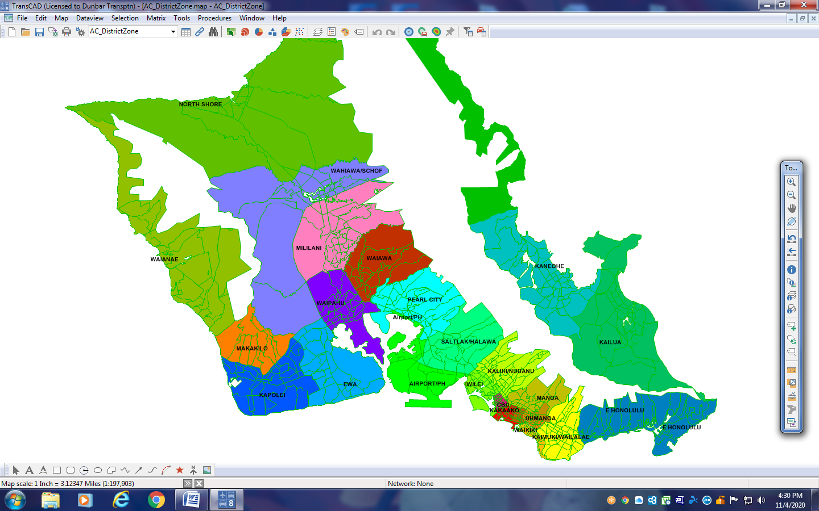
Honolulu District Structure (26)
OMPO STOPS Training WSP/Dunbar Transportation Consulting LLC

Slide 68
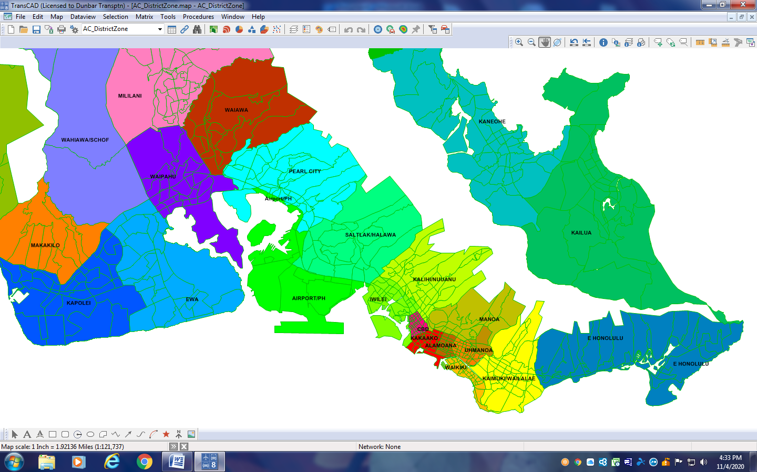
Honolulu District – Project Area
OMPO STOPS Training WSP/Dunbar Transportation Consulting LLC

Slide 69
Honolulu Districts
Number | Name
1 | CBD
2 | Kakaako
3 | MAKIKI
4 | WAIKIKI
5 | KAIMUKI/WAILALAE
6 | KALIHI/NUUANU
7 | IWILEI
8 | AIEPORT/PH
9 | SALTLAK/HALAWA
10 | PEARL CITY
11 | EWA
12 | KAPOLEI
13 | MAKAKILO
Number | Name
14 | WAIPAHU
15 | WAIAWA
16 | MILILANI
17 | WAHIAWA/SCHOF
18 | E HONOLULU
19 | KANEOHE
20 | KAILUA
21 | WINDWARD
22 | NORTH SHORE
23 | WAIANAE
24 | MANOA
25 | UHMANOA
26 | ALAMOANA
OMPO STOPS Training WSP/Dunbar Transportation Consulting LLC

Slide 70
Route_ID | Route Name | 2017 APC Count | 2017 STOPS
2 | 2-Waikiki-School-Middle | 14720 | 16018
127 | 13-Liliha-Waikiki-University | 13012 | 6301
22 | A-City Express! A | 12957 | 15475
1 | 1-Kaimuki-Kalihi | 12127 | 8925
3 | 3-Kaimuki-Salt Lake | 11159 | 10197
26 | 40-Honolulu-Makaha | 9580 | 6149
28 | 42-Ewa Beach-Waikiki | 9362 | 7327
4 | 4-Nuuanu-Punahou | 6421 | 5895
40 | C-Country Express! C | 5885 | 7523
109 | E-Country Express! E | 5588 | 12631
131 | 62-Honolulu-Wahiawa | 5527 | 5927
126 | 9-Kaimuki-Pearl Harbor | 5379 | 4262
6 | 6-Pauoa-Woodlawn | 5264 | 4073
18 | 19-Waikiki-Airport-Hickam | 4423 | 3976
102 | 1L-School Street-Hawaii Kai | 4267 | 8526
Notes:
2017 Calibration – top 15 routes (source results.prn table 10.01)

Slide 71
Observations on 2017 Calibration
Use of 26 stop groups (same as 26 districts)
More details definition of stop groups
Individual Route calibration
Path Choice Complexities
Express routes

Slide 72
2019 Calibration
OMPO STOPS Training WSP/Dunbar Transportation Consulting LLC

Slide 73
Honolulu – 2019 Current Year
Updated APC to 2019 data
Updated GTFS to 2019 bus
Could not update 2015 demographics or highway LOS
2017 Calibration control file revised to point to 2019 inputs
Zones, Districts, Station Groups remain the same
Current Year = NoBuild for Honolulu 2019
OMPO STOPS Training WSP/Dunbar Transportation Consulting LLC

Slide 74
Route_ID | Route Name | 2019 APC Count | 2019 Base STOPS
2 | 2-Waikiki-School-Middle | 17680 | 12363
1 | 1-Kaimuki-Kalihi | 13238 | 8515
127 | 13-Liliha-Waikiki-University | 11995 | 6934
22 | A-City Express! A | 11433 | 14397
3 | 3-Kaimuki-Salt Lake | 9403 | 8750
28 | 42-Ewa Beach-Waikiki | 8228 | 6859
26 | 40-Honolulu-Makaha | 8147 | 4937
4 | 4-Nuuanu-Punahou | 5521 | 5026
109 | E-Country Express! E | 4838 | 12187
126 | 9-Kaimuki-Pearl Harbor | 4800 | 3309
40 | C-Country Express! C | 4672 | 6692
6 | 6-Pauoa-Woodlawn | 4547 | 3699
131 | 51-Honolulu-Wahiawa | 4545 | 4755
18 | 19-Waikiki-Airport-Hickam | 4229 | 3967
139 | 60-Honolulu-Kaneohe-Haleiwa | 3590 | 5455
Notes:
2019 Calibration – Comparison of top 15 routes (source: results.prn table 10.01)

Slide 75
2019 Rail Test Run

Slide 76
Recommended Next Steps
Contact FTA Help Desk to resolve peak period issue for zero rider routes
Could refine station groups to break up into smaller route groups (max of 250 available)
Review rail test run GTFS networks for consistency with 2019 calibration GTFS
Could add PNR lots for rail test run (consult with FTA Help Desk)
Could consider visitors as an external add in to STOPS (consult with FTA Help Desk)
ATTEND NTI/FTA STOPS TRAINING

Slide 77
STOPS File Structure
OMPO STOPS Training WSP/Dunbar Transportation Consulting LLC

Slide 78
Housekeeping Details:
Each STOPS run prepares three forecasts in parallel:
Current Year
Nobuild
Build
For the initial 2019 Calibration all three are set to the 2019 Bus system without the rail line
The parameter file is based on the 2017 Calibration with the input GTFS updated to point to 2019 files.
OMPO STOPS Training WSP/Dunbar Transportation Consulting LLC

Slide 79
STOPS File Structure
Honolulu_2019
Districts
GTFOutput
Inputs*
Logfiles
OutputData
Reports
Scratch
Skims
Stops
Honolulu_2019.ctl*
OP_TR_BLD-
OP_TR_EXST
OP_TR_NOBL
PK_TR_BLD
PK_TR_EXST
PK_TR_NOBL
DEC19
*Required files for to start a run, others are created by STOPS
OMPO STOPS Training WSP/Dunbar Transportation Consulting LLC

Slide 80
Notes to Remember
Some inputs are not scenario specific and should always be carried forward as INPUTS:
District definition file
Forecast-year definition file
Station file (and stop_IDs)
Walk-links shape files
MPO information (including TAZ system)
CTPP files (including CTPP zone system)
Note: STOPS geographically overlays MPO and CTPP zones
OMPO STOPS Training WSP/Dunbar Transportation Consulting LLC

Slide 81
The STOPS Interface-How to Run It!
OMPO STOPS Training WSP/Dunbar Transportation Consulting LLC

Slide 82
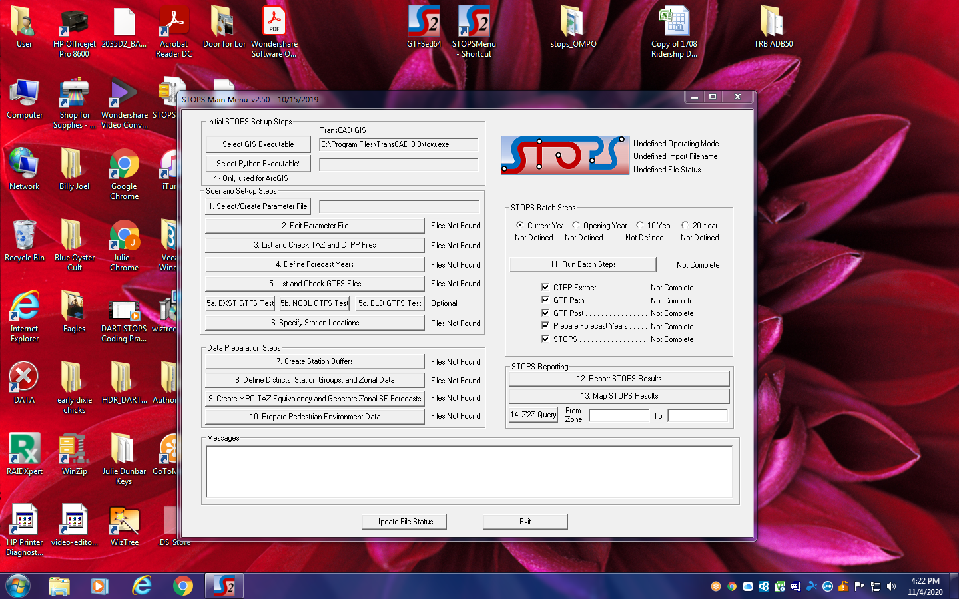
The STOPS Graphical User Interface
OMPO STOPS Training WSP/Dunbar Transportation Consulting LLC

Slide 83
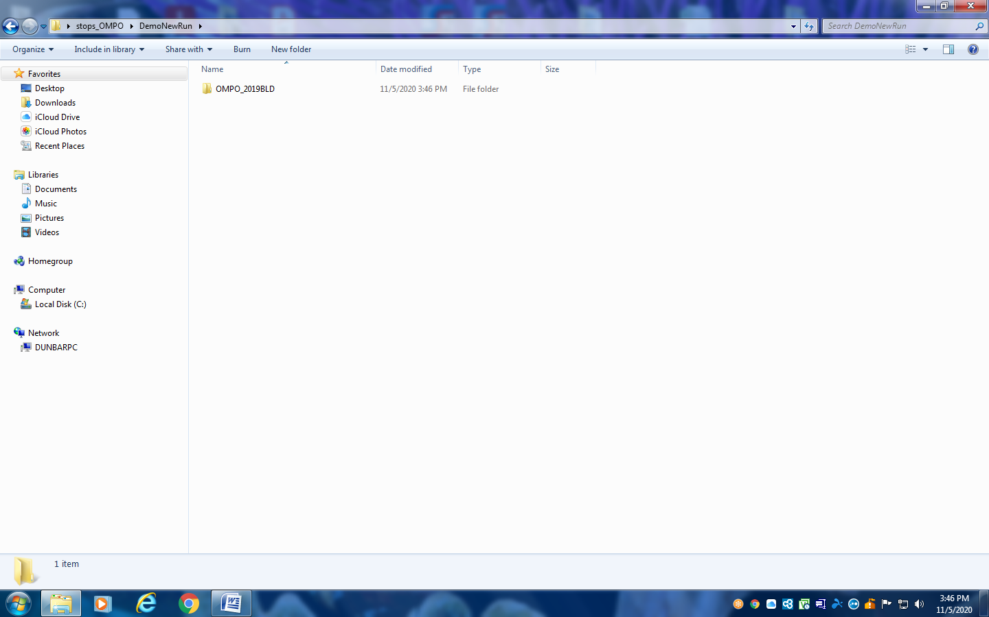
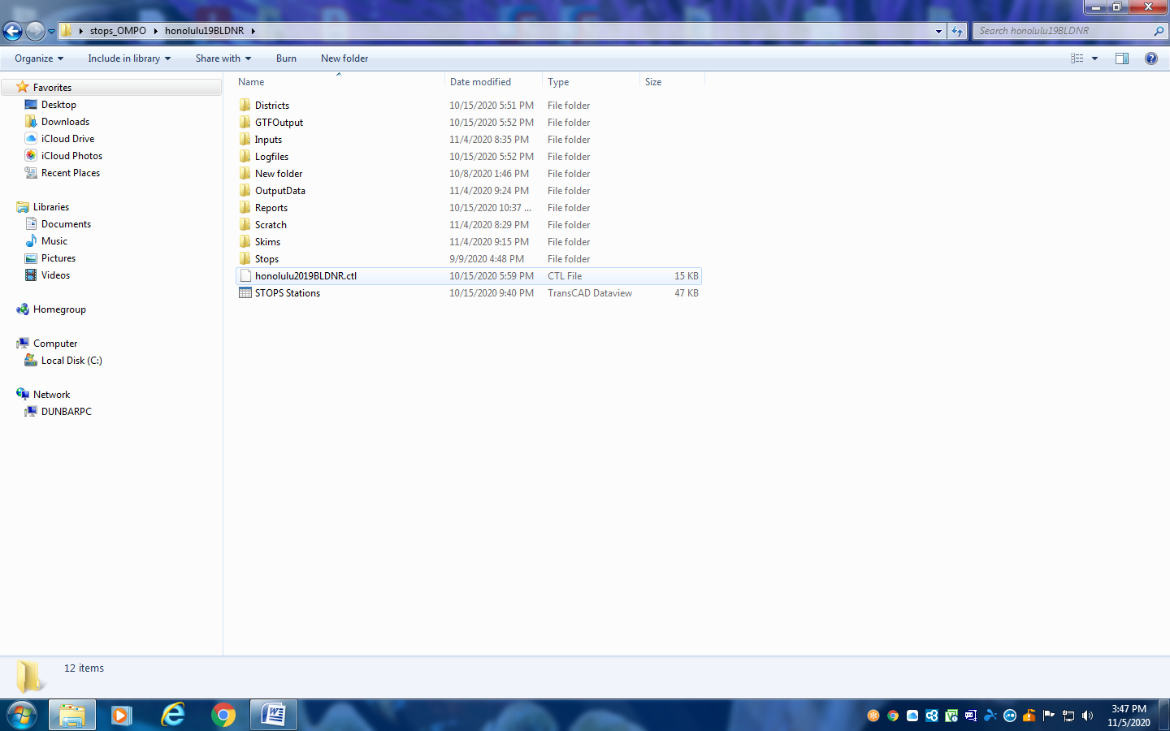
STOPS Getting Started
Create new run folder
Copy INPUTS and .ctl from previous run
OMPO STOPS Training WSP/Dunbar Transportation Consulting LLC

Slide 84
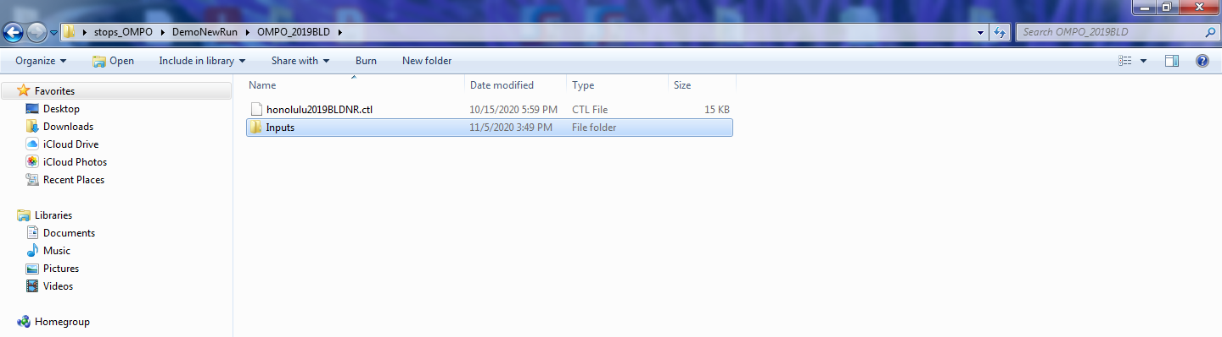
STOPS File Structure
Paste INPUTS and .CTL from previous STOPS run
STOPS will generate all remaining folders for a model run but these two are essential to start.
There are several key items that should always be in the INPUTS folder.....
OMPO STOPS Training WSP/Dunbar Transportation Consulting LLC

Slide 85
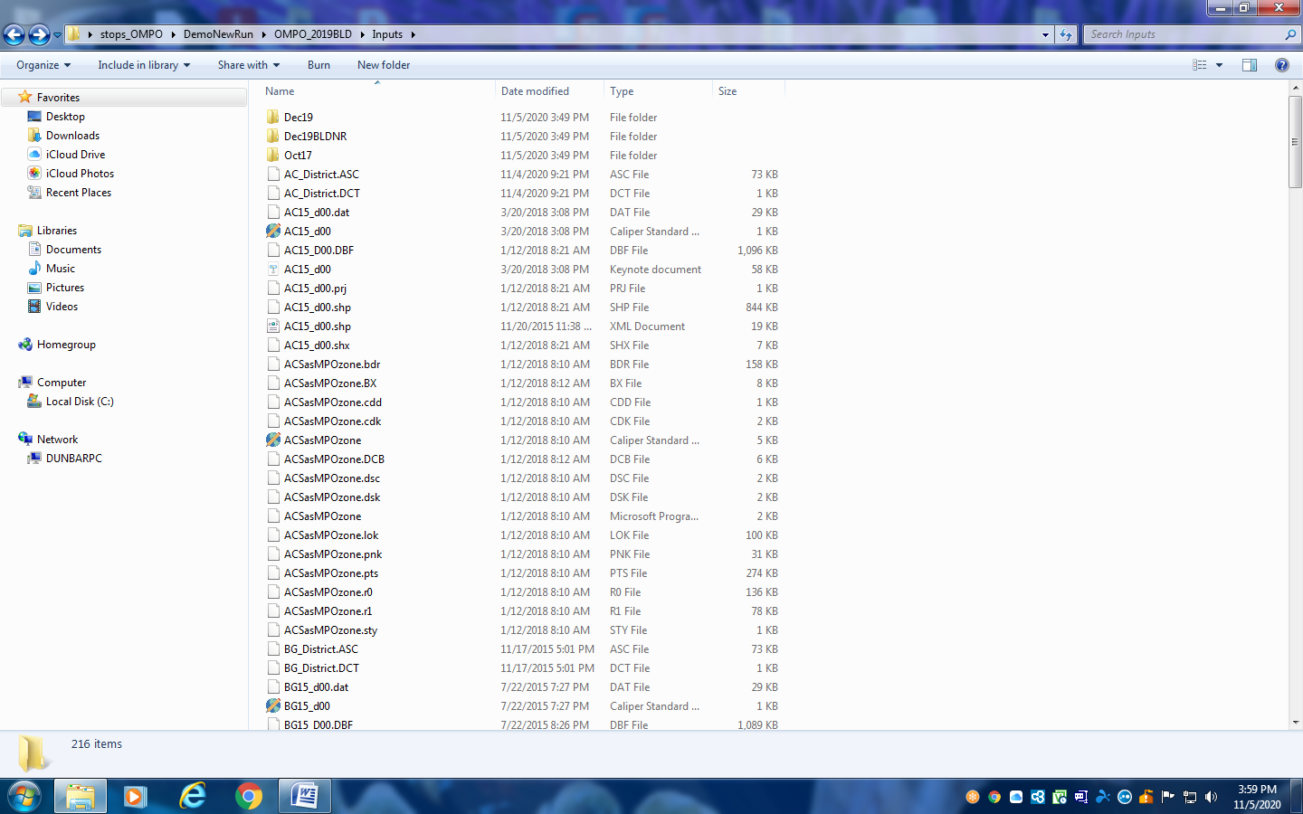
INPUTS Folder – OMPO 2019 BLD
GTFS Files for Existing NoBuild and Build
ACS/CTPP, MPO demographic and highway files, walk links, district/TAZ equivalencies and data from calibration.
OMPO STOPS Training WSP/Dunbar Transportation Consulting LLC
Notes:
For a particular set of STOPS runs, it is common practice to copy the inputs file from run to run while adding new GTFS as needed. This ensures that the data used to develop the STOPS Calibration and the proceeding model runs stays together. This is a place where FTA Help Desk consultation could be helpful.

Slide 86
STEPS to Configure STOPS
Step 1. Create/select parameter file
Step 2. Edit parameter file
Step 3. List and check TAZ & CTPP filenames
Step 4. Define forecast years
Step 5. List and check GTFS files
Step 6. Specify station locations
OMPO STOPS Training WSP/Dunbar Transportation Consulting LLC

Slide 87
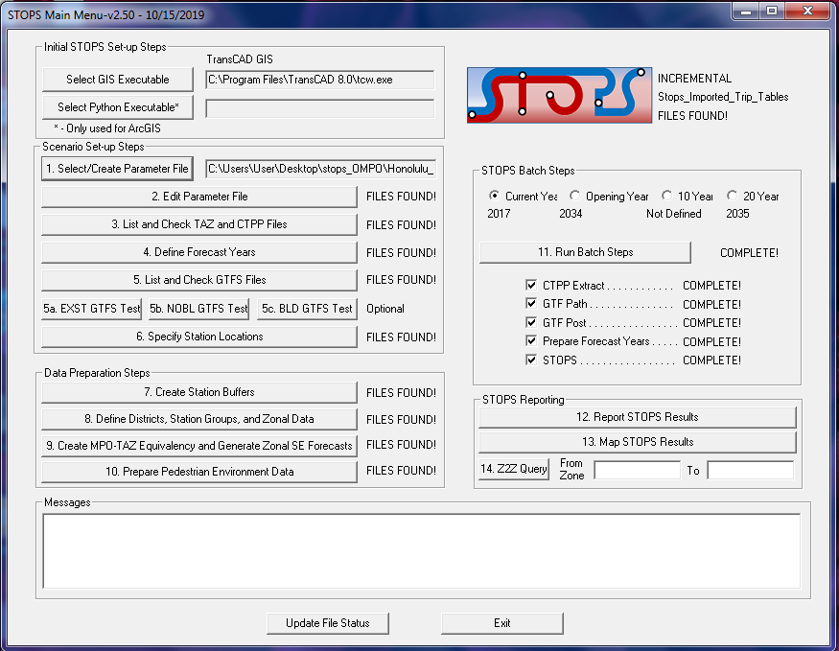
Step 1. Select/Edit Parameter File
Select .ctl file
OMPO STOPS Training WSP/Dunbar Transportation Consulting LLC

Slide 88
Step 1. Select/Edit Parameter File
honolulu2019.ctl file exists – based on previous Calibration parameters
Possible edits include GTFS updates/Model Run Name identifier
STOPS has the ability to create a parameter file from scratch. But there’s no need for that with OMPO STOPS application as it’s been done!
OMPO STOPS Training WSP/Dunbar Transportation Consulting LLC

Slide 89
Purpose of the Parameter File
✅ Defines the geography type of the CTPP (ACS) data
✅ Identifies the appropriate state and MPO
⁉️ Identifies subfolder location of each GTFS file set
✅ Provides trip rates by purpose and autos owned
✅ Provides linked transit trips by purpose and autos owned
⁉️ Specifies the fixed guideway settings
✅ Specifies the CTPP-transit calibration method
✅ Specifies the station-group calibration method
⁉️ Sets the transfer penalty and access mode parameters
Where, ✅ indicates items already set for Honolulu and,
⁉️ indicates items that may change for BLD runs
OMPO STOPS Training WSP/Dunbar Transportation Consulting LLC
Notes:
This file is the ‘nerve center’ of a STOPS application – all the important parameters and inputs are specified here.

Slide 90
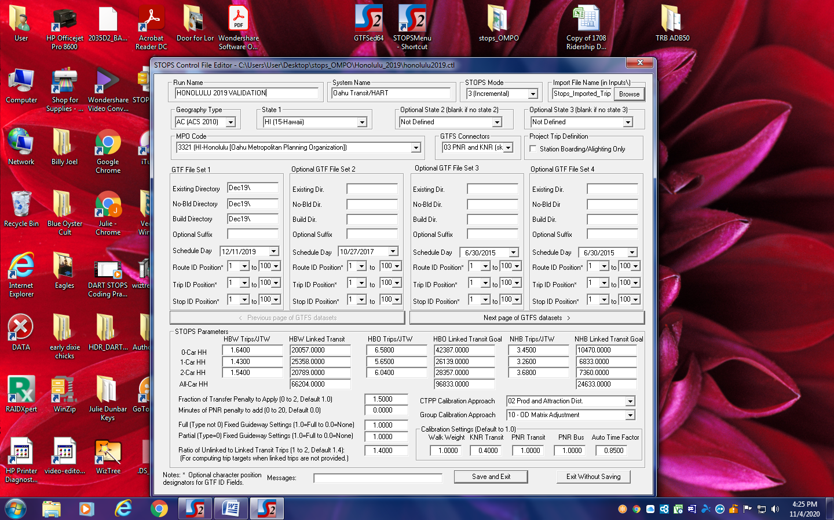
honolulu2019.ctl
Possible Updates:
Run Name
GTFS Files
Schedule Day
Group Calibration = 10 does not change
OMPO STOPS Training WSP/Dunbar Transportation Consulting LLC
Notes:
Group Calibration = 10 always stays the same for OMPO Application as OBS was available initially.

Slide 91
Steps to Configure STOPS
Step 1. Create/select parameter file
Step 2. Edit parameter file
Step 3. List and check TAZ & CTPP filenames
Step 4. Define forecast years
Step 5. List and check GTFS files
Step 6. Specify station locations
OMPO STOPS Training WSP/Dunbar Transportation Consulting LLC

Slide 92
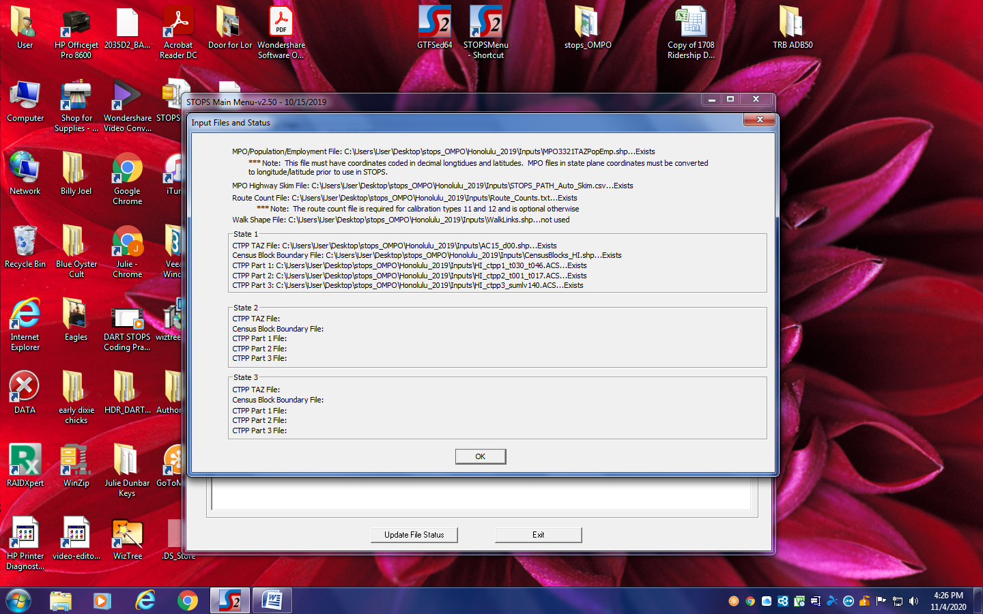
Step 3. List and check TAZ/CTPP files
OMPO STOPS Training WSP/Dunbar Transportation Consulting LLC

Slide 93
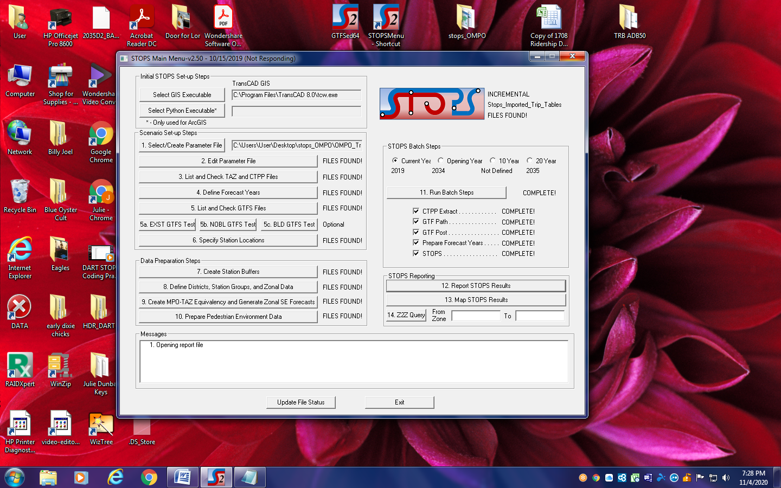
Step 4. Define forecast years
Define Forecast Years
OMPO STOPS Training WSP/Dunbar Transportation Consulting LLC

Slide 94
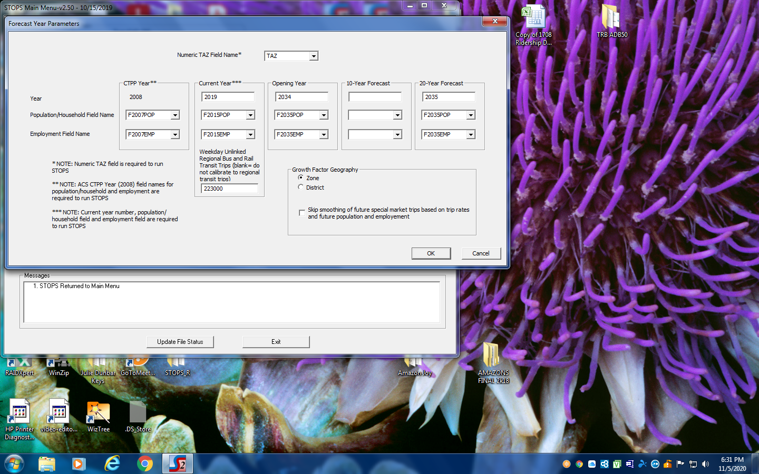
Step 4. Define forecast years
Define Forecast Years❓
CTPP –do not change
❓
❓
2015Pop/Emp – could be changed?
Weekday Unlinked Transit Trips – from 2012 OBS – do not change!
OMPO STOPS Training WSP/Dunbar Transportation Consulting LLC

Slide 95
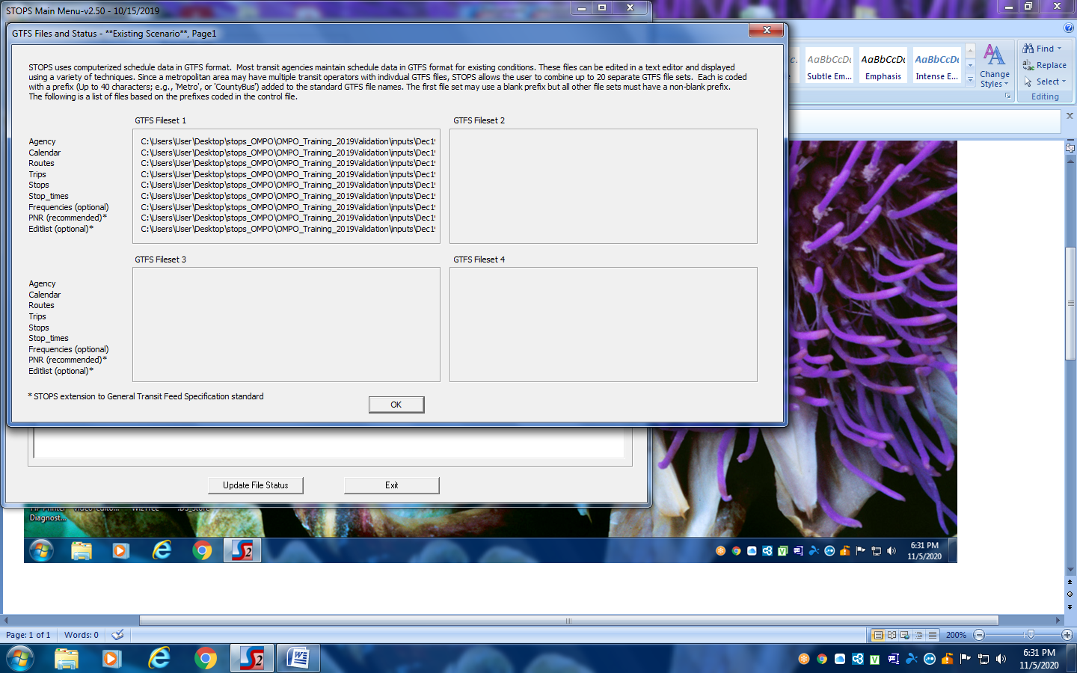
Step 5. List and check GTFS files
OMPO STOPS Training WSP/Dunbar Transportation Consulting LLC

Slide 96
Step 6. Specify station locations
Specify Station Locations
OMPO STOPS Training WSP/Dunbar Transportation Consulting LLC

Slide 97
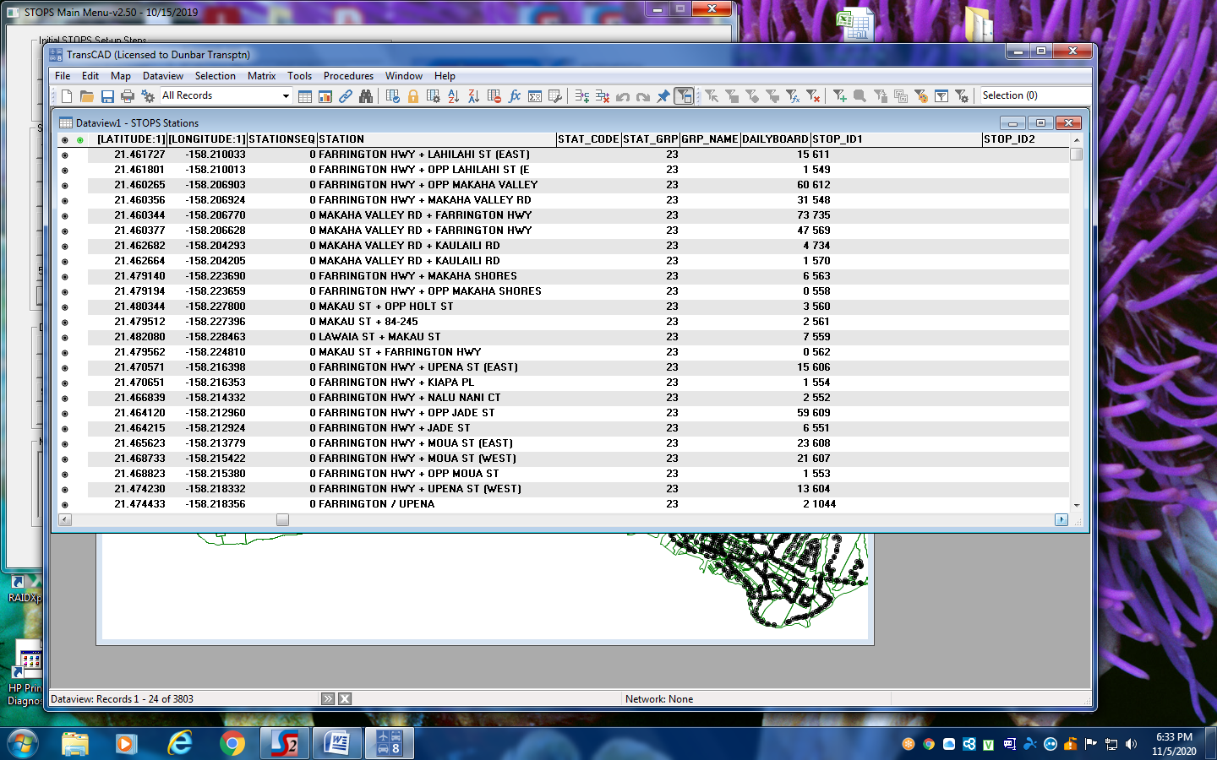
Step 6. Specify station locations
OMPO STOPS Training WSP/Dunbar Transportation Consulting LLC

Slide 98
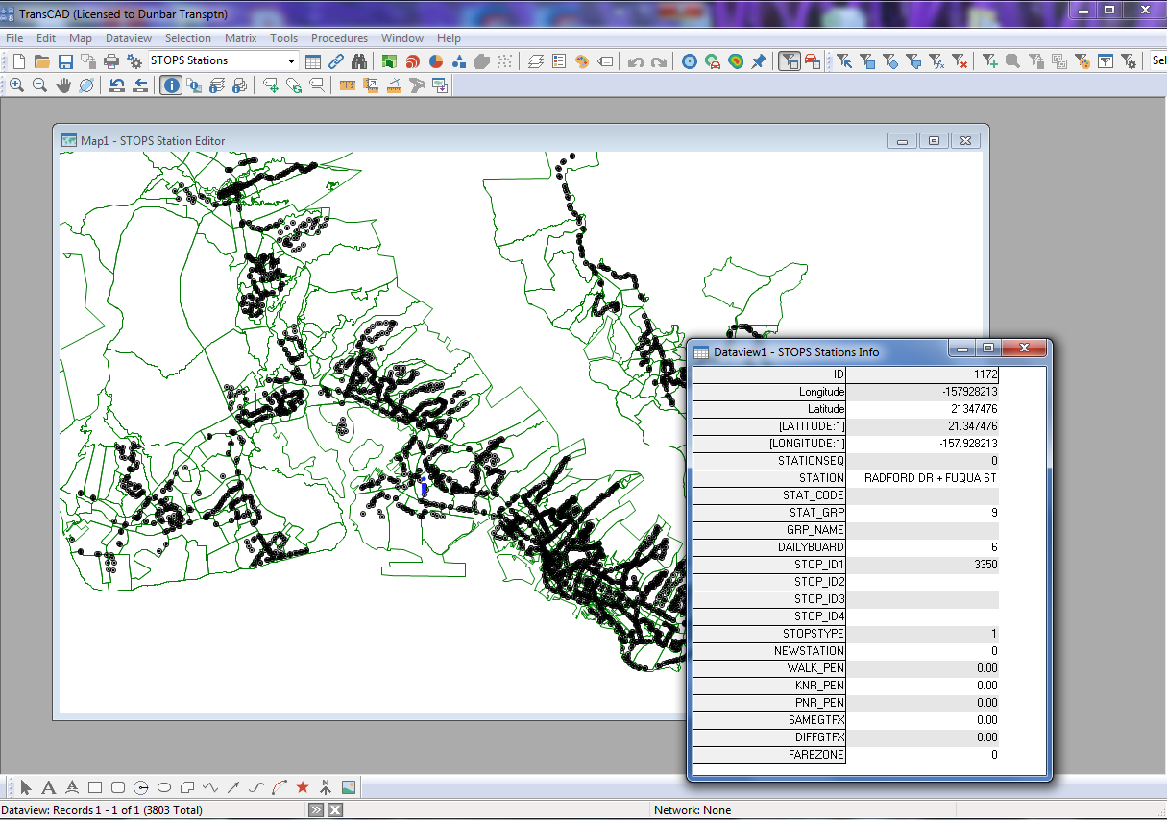
Step 6. Specify station locations
OMPO STOPS Training WSP/Dunbar Transportation Consulting LLC

Slide 99
Steps to prepare data...
Step 7. Create station buffers (reads station file and selects zones within 25 miles)
Step 8. Define districts, station groups and zonal data (already specified for OMPO)
Step 9. Create MPO-TAZ equivalency (reads CTPP and MPO TAZ layers; create equivalency; assign MPO demographics to CTPP zones)
Step 10. Prepare pedestrian environment (determine census blocks per square mile for each zone)
OMPO STOPS Training WSP/Dunbar Transportation Consulting LLC
Notes:
These steps don’t require any interaction – just need to be run.

Slide 100
Steps to RUN STOPS
Step 11. Run Batch Steps
CTPP Extract (read CTPP, create trip/skim shell for each scenario)
GTF Path (build transit paths/skims)
GTF Post (post transit skims to trip/skim file)
Prepare Forecast Years (grow trips in trip/skim file for horizon year)
STOPS (run demand model to predict ridership for current, no-build, build)
Step 12. Report STOPS Results (report file tables)
Step 13. Map STOPS Results (open GIS to view thematic maps)
Step 14. Z2Z Query (show skims/trips for a particular interchange)
OMPO STOPS Training WSP/Dunbar Transportation Consulting LLC

Slide 101
Results of a STOPS Run
OMPO STOPS Training WSP/Dunbar Transportation Consulting LLC

Slide 102
Results Table Directory
Automatically saved in ‘results’ subdirectory
Filename ends with results.prn
Opens in notepad or text editor window
Contains 15 sections
Easiest to find the table by searching on the table number
OMPO STOPS Training WSP/Dunbar Transportation Consulting LLC

Slide 103
OMPO STOPS Training WSP/Dunbar Transportation Consulting LLC
Notes:
Report File Index, part 1

Slide 104
OMPO STOPS Training WSP/Dunbar Transportation Consulting LLC
Notes:
Report file and index, part 2

Slide 105
OMPO STOPS Training WSP/Dunbar Transportation Consulting LLC
Notes:
Report file and index, part 3 – section 15 see next slide for description

Slide 106
Report File Index Table 15
Lists table numbers in the Table 15 matrix
Every table is also a matrix – D2D or Station to Station in P/A format
Columns represent the type of trip reported
Rows represent the statistic, trip purpose and auto ownership levels included in each table
OMPO STOPS Training WSP/Dunbar Transportation Consulting LLC

Slide 107
Table 15 Column Definitions
Transit Trips
Transit Path Type
FGO – Fixed guideway only
FGB – Fixed guideway and bus
BUS – Bus only
TRN – Any transit (sum of above)
FG – Any fixed guideway (sum of FGO and FGB)
Access Mode
WLK – Walk
KNR – Kiss and Ride
PNR – Park and Ride
All – Sum of the above access modes
Total Person Trips
All Mode – the estimate of person trips used to generate the estimate of transit trips
OMPO STOPS Training WSP/Dunbar Transportation Consulting LLC

Slide 108
Table 15 Row Definitions
Statistic
Scenario
Existing
No-build
Build
Matrix Type
District to district linked trips
Station to station total flows
Other
Incremental (Build – No-Build) district to district linked trips
Linked Trips on project – D2D linked trips that use the project
Station to station project flows – statistic usage by project flows
Trip Purpose
HBW – Home based work
HBO – Home based other
NHB – Non home based
ALL – sum of above
Household Auto Ownership
0 – 0 cars in household
1 - 1 car in household
2 – 2 or more cars in household
ALL – sum of above
OMPO STOPS Training WSP/Dunbar Transportation Consulting LLC

Slide 109
Accessing Results
R-Script to support working with output
Set up to extract select tables from results.prn
Generates each as a separate CSV and TXT file
Options for selecting desired tables depending on STOPS run needs
Developed and supported by WSP
OMPO STOPS Training WSP/Dunbar Transportation Consulting LLC

Slide 110
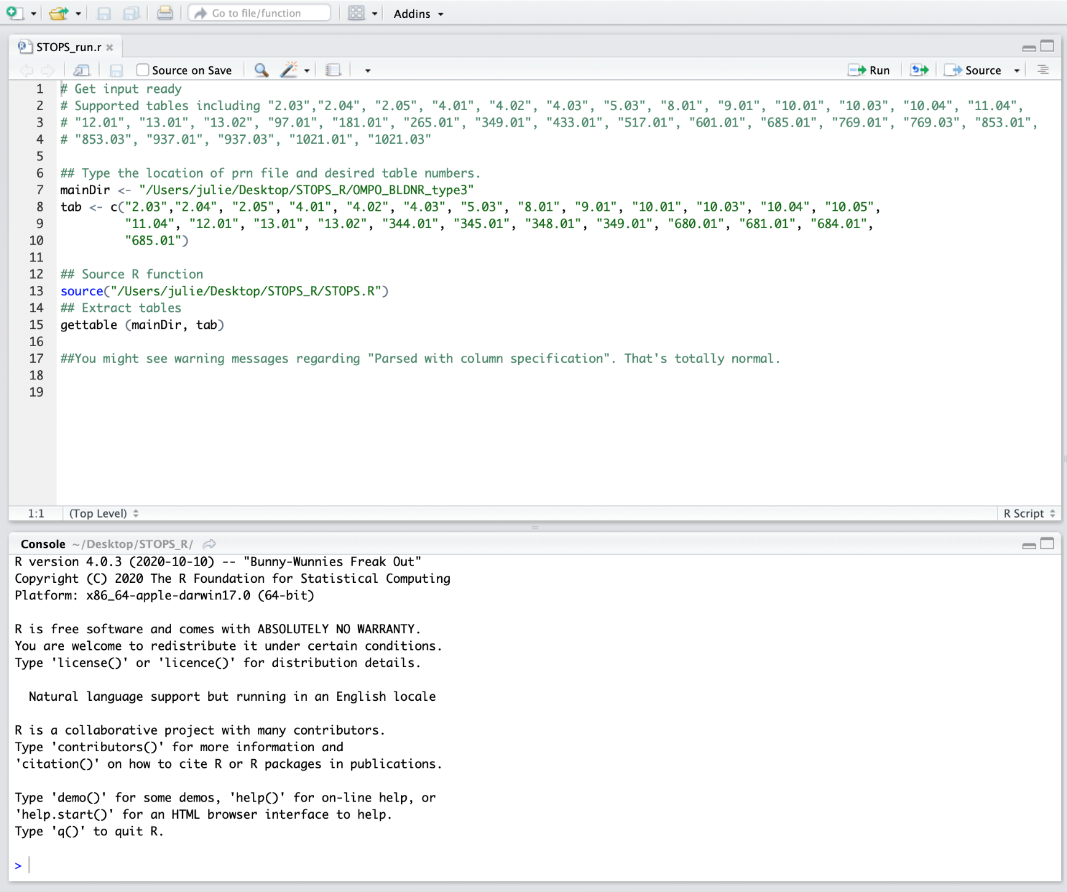
R-Script

Slide 111
Tables might vary with application but here are a few suggestions:
2.05 – station group boarding factors – check for reasonableness
4.01/2/3/4-Linked Weekday Transit Trips all purposes (Build, Incremental and Project)
5.01/2/3/4 – Linked Weekday Transit Trips on FG
9.01 – Station Boardings by Mode of Access (Existing, NoBuild and Build)
10.01 – Route boardings by mode of access
11.01/2/3/4- Summary of trips by purpose, submode, access mode, auto ownership and scenario

